Slide 1



SENTIMENT ANALYSIS
Presented By:
Himanshu Patel , Akarsh Mathur, Harshit Jain and Kunal Sahu
0126IT181027, 0126IT181003, 0126IT181026, 0126IT181035
INFORMATION TECHNOLOGY 6TH SEM “A”

Slide 2
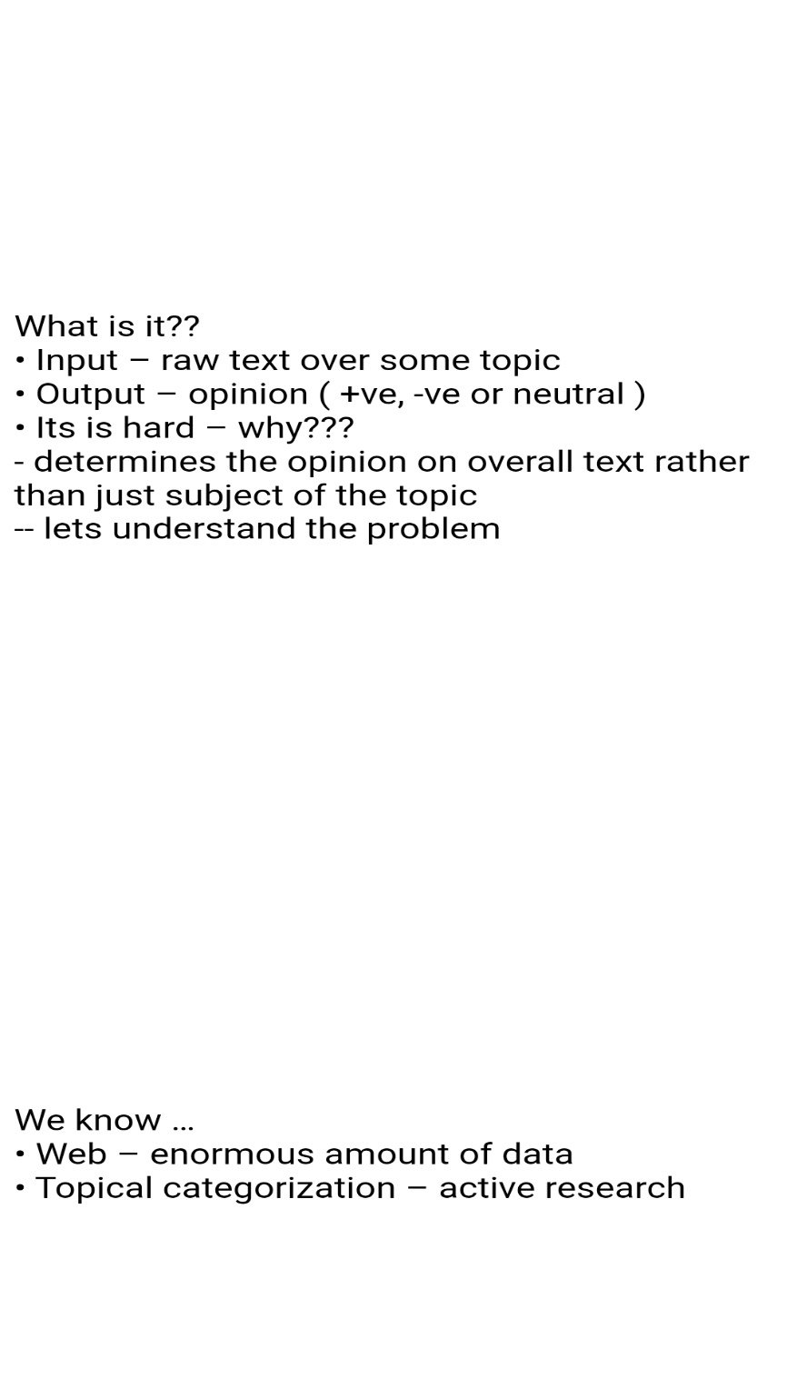

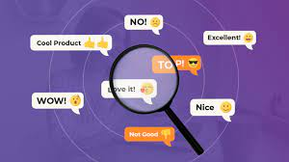
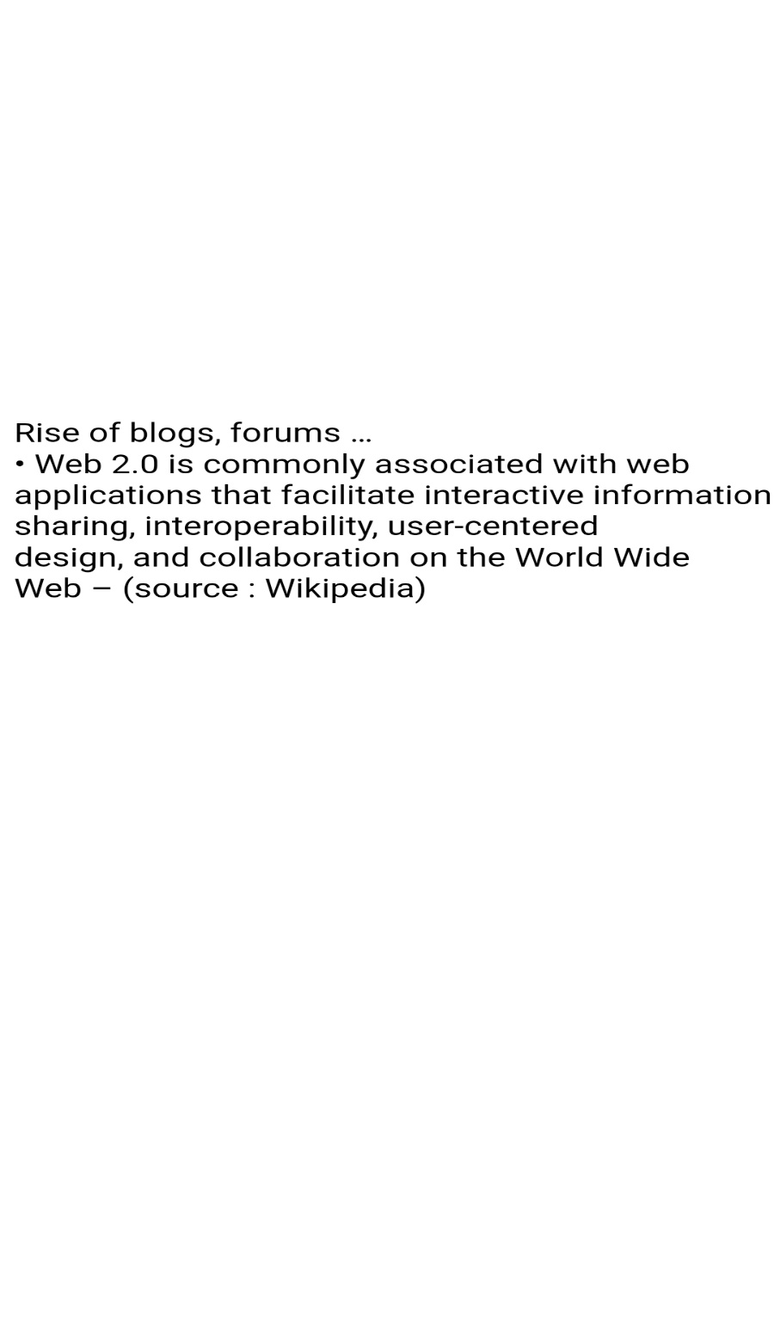

Slide 3
Objective
The project mainly deals analysis of product reviews from various ecommerce websites.
Our Main objective is to get the overall polarity of reviews for a particular product.

Slide 4
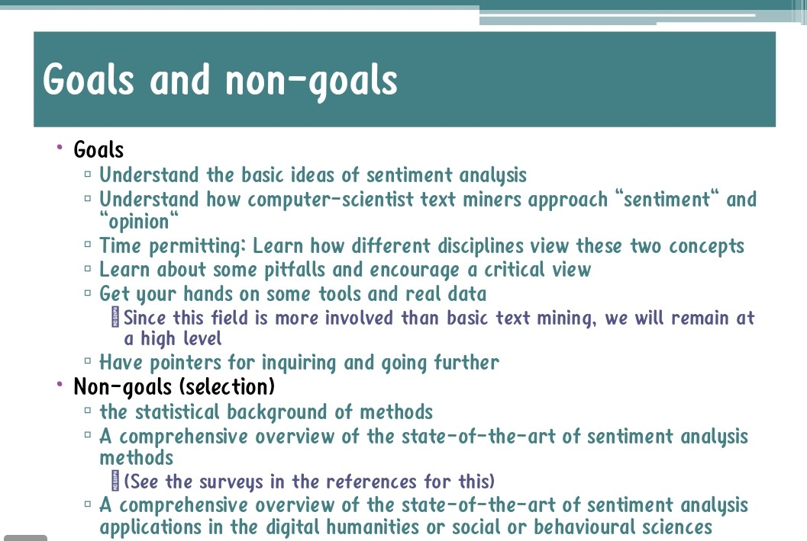

Slide 5
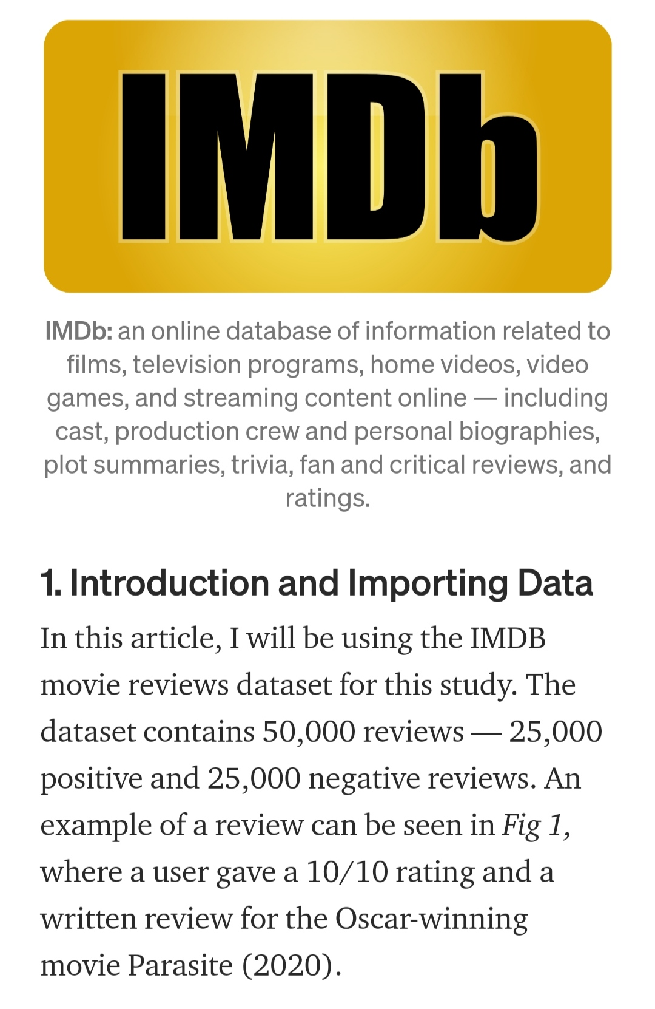
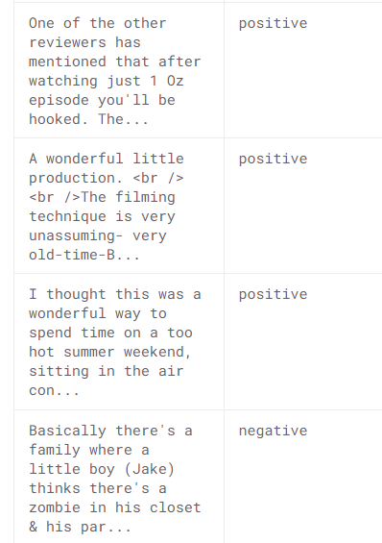
DATA SETS
Figure 1

Slide 6
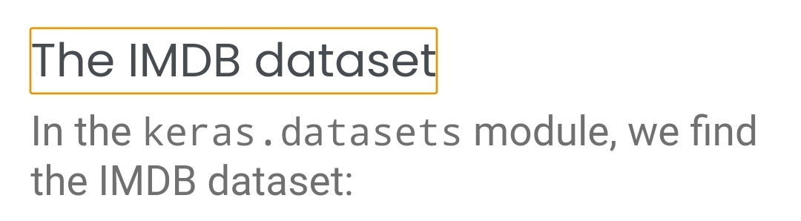
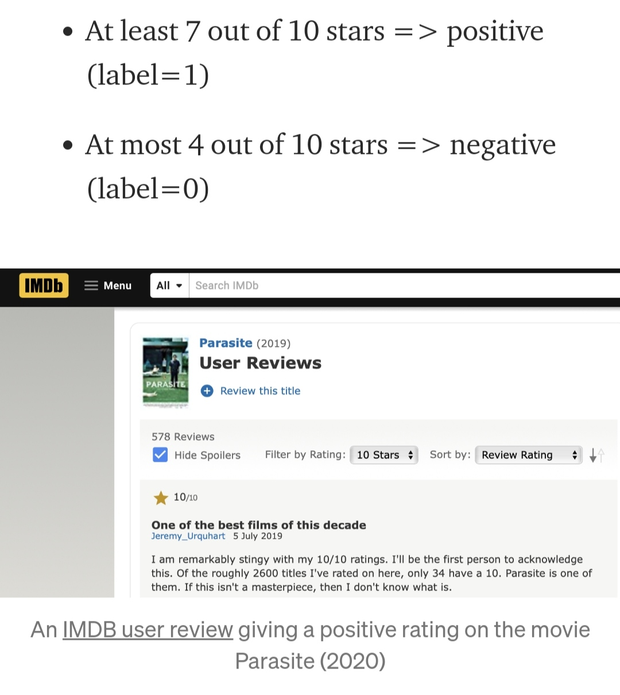

Slide 7
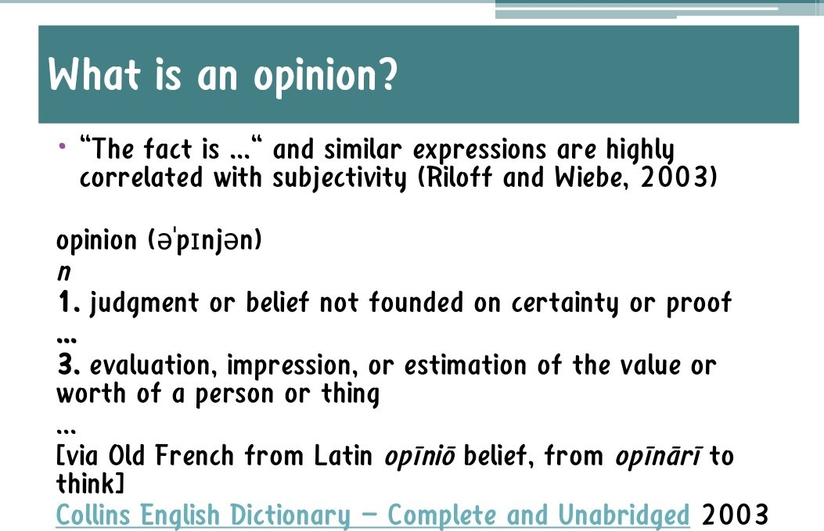

Slide 8
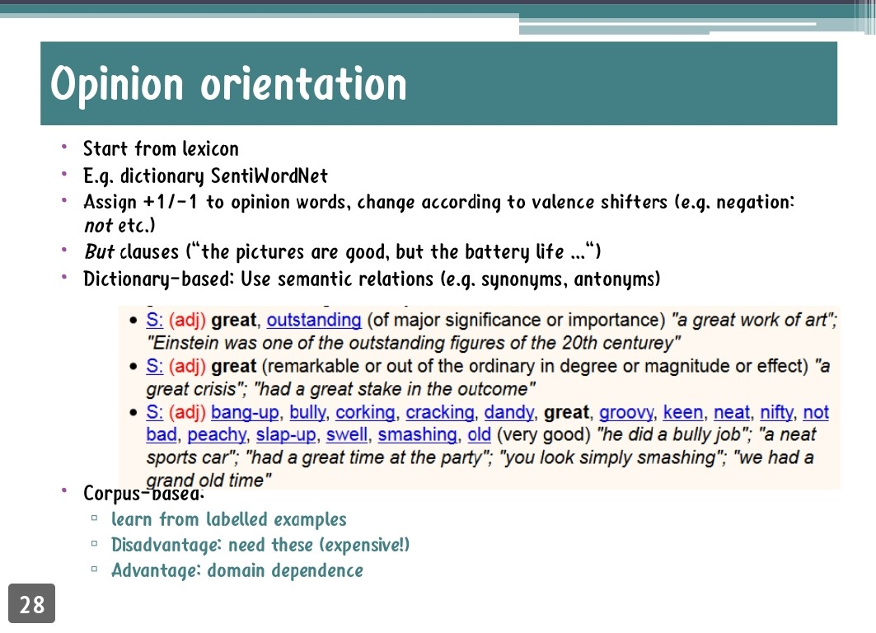

Slide 9
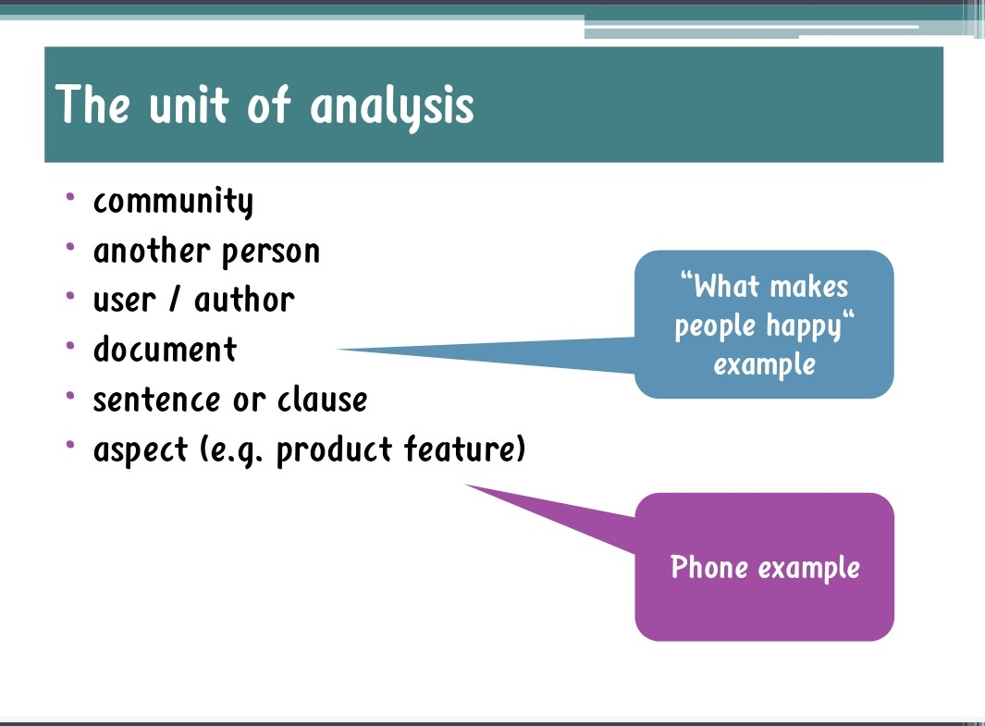

Slide 10
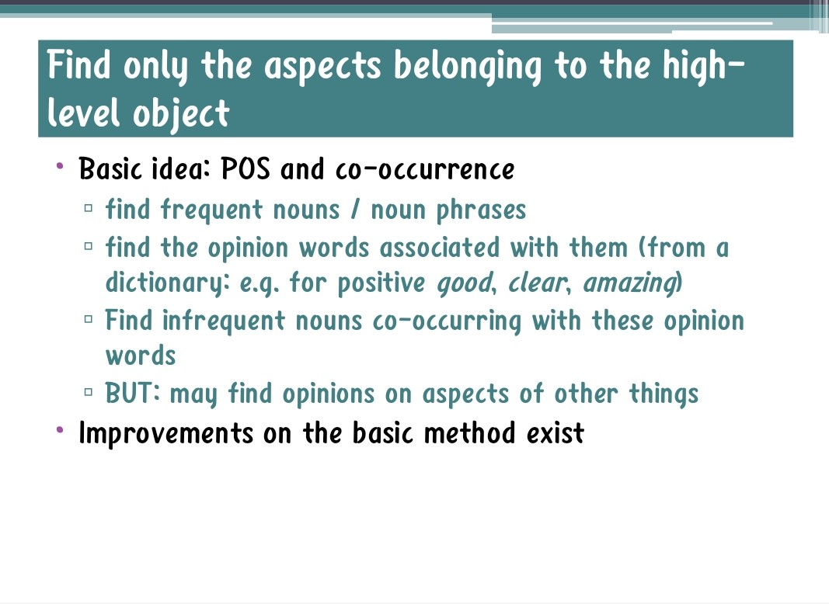

Slide 11

Sentiment Analysis
Identify the orientation of opinion in a piece of text
Can be generalized to a wider set of emotions
The movie
was fabulous!
The movie
stars Mr. X
The movie
was horrible!
[ Sentimental ]
[ Factual ]
[ Sentimental ]
References: google images

Slide 12
Sentiment Analysis
Movie: is this review positive or negative?
Products: what do people think about the new iPhone?
Public sentiment: how is consumer confidence?
Is despair increasing?
Politics: what do people think about this candidate or issue?
Prediction: predict election outcomes or market trends
from sentiment

Slide 13
Sentiment analysis has many other names
Opinion extraction
Opinion mining
Sentiment mining
Subjectivity analysis

Slide 14
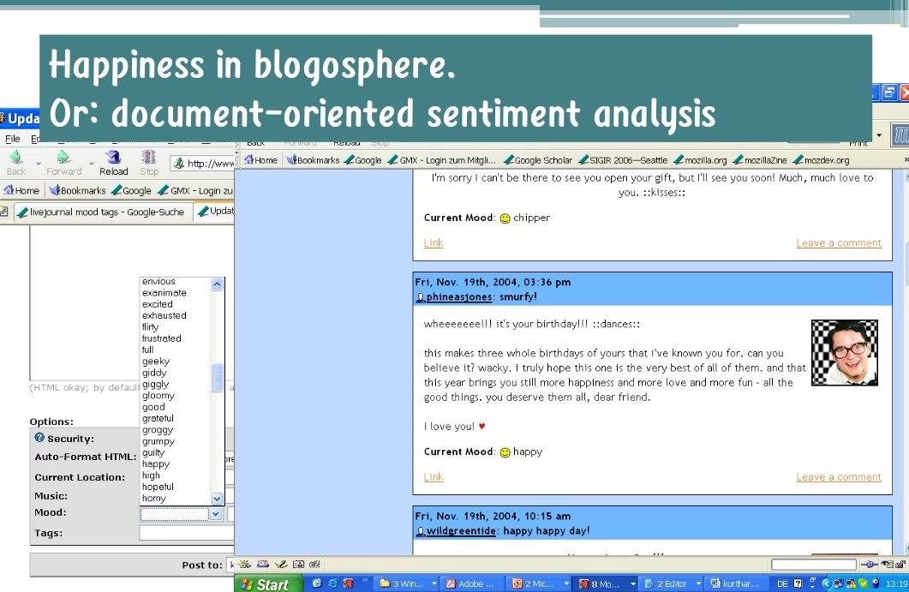

Slide 15
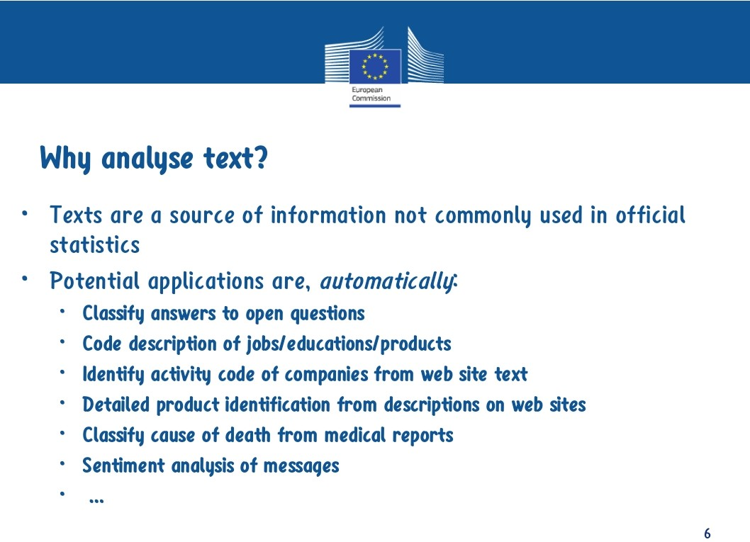

Slide 16
Google Product Search

Slide 17
Case Diagram
Texts
Sentences
Noun
Adjective
Positive
Neutral
Negative
Polarity

Slide 18
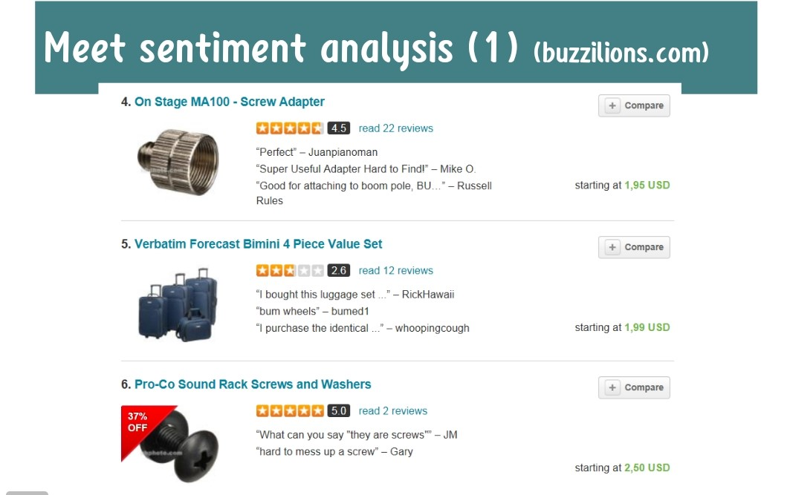

Slide 19
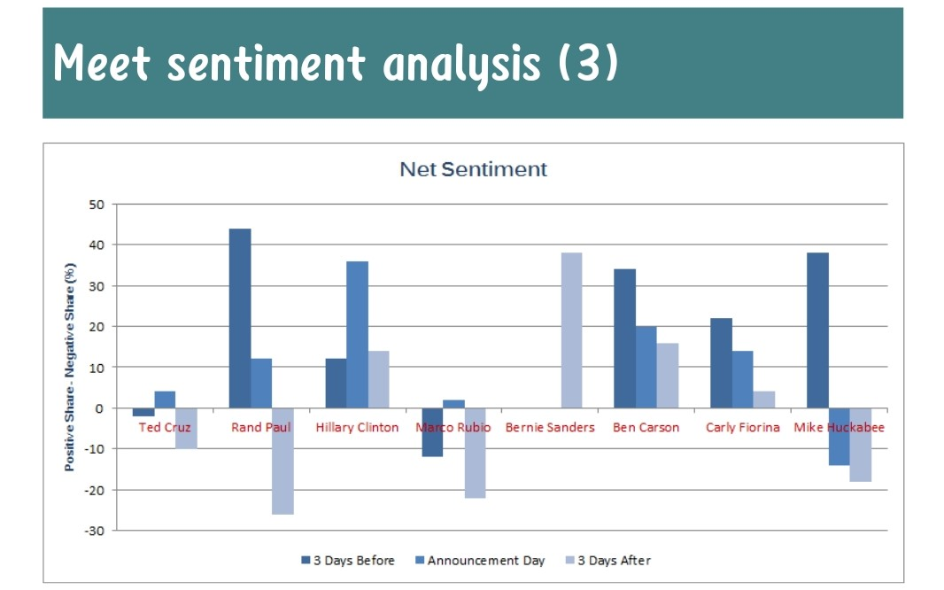

Slide 20
Areas To Be covered for Sentiment Analysis
Long Short-Term Memory (LSTM)
Recurrent Neural Networks
Word Embeddings
Convolutional Neural Networks
DropOut
Padding
TensorFlow.Keras
Average Pooling and Pooling Layers
Adam Optimizer

Slide 21
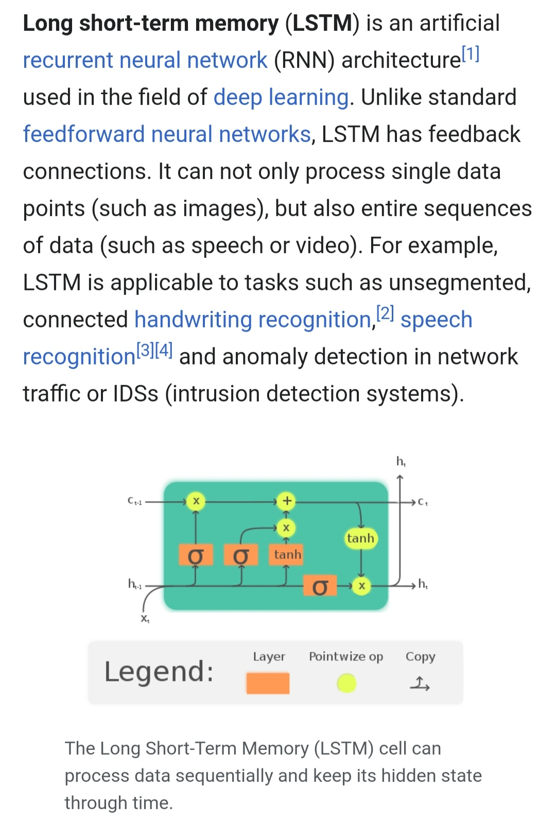
Long Short-Term Memory (LSTM)
Long short-term memory (LSTM) is an artificial recurrent neural network (RNN) architecture used in the field of deep learning. Unlike standard feedforward neural networks, LSTM has feedback connections. It can not only process single data points (such as images), but also entire sequences of data (such as speech or video). For example, LSTM is applicable to tasks such as unsegmented, connected handwriting recognition, speech recognition and anomaly detection in network traffic or IDSs (intrusion detection systems).

Slide 22
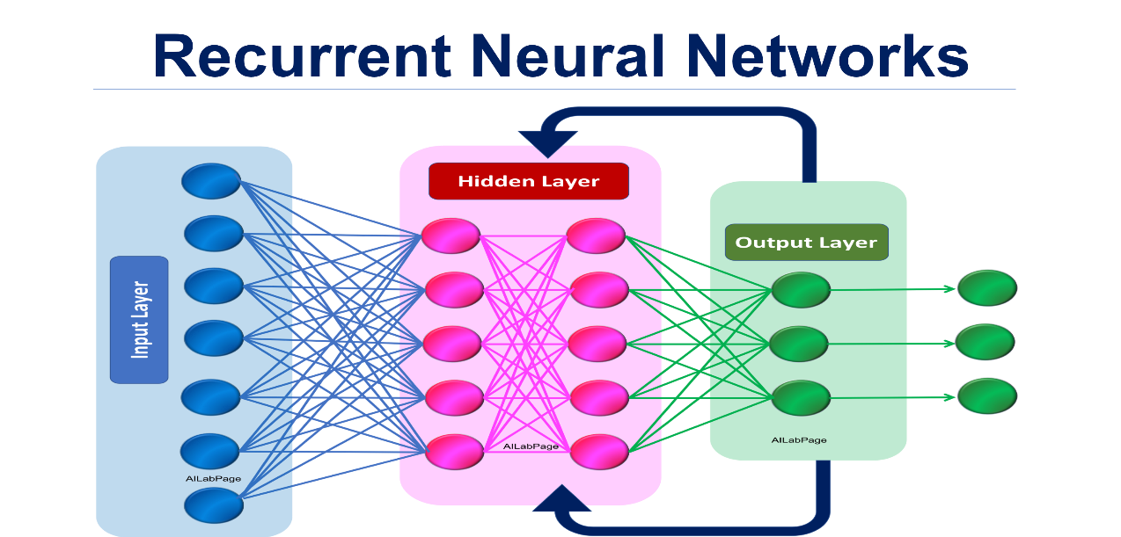
Recurrent Neural Networks
A recurrent neural network (RNN) is a class of artificial neural networks where connections between nodes form a directed graph along a temporal sequence. This allows it to exhibit temporal dynamic behavior. Derived from feedforward neural networks, RNNs can use their internal state (memory) to process variable length sequences of inputs. This makes them applicable to tasks such as unsegmented, connected handwriting recognition or speech recognition.

Slide 23
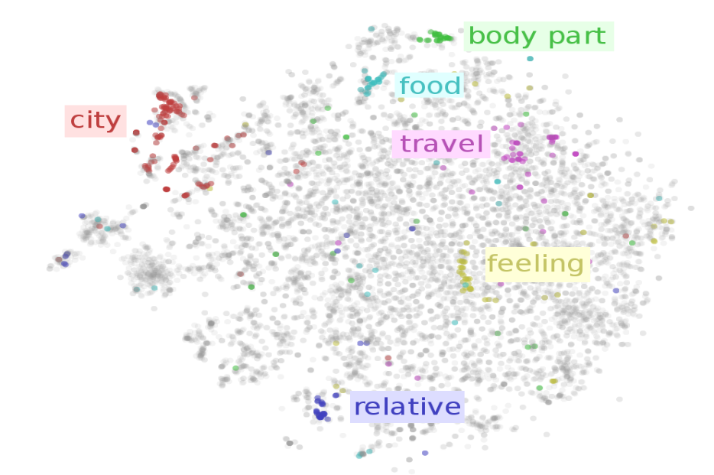
Word Embedding
In natural language processing (NLP), Word embedding is a term used for the representation of words for text analysis, typically in the form of a real-valued vector that encodes the meaning of the word such that the words that are closer in the vector space are expected to be similar in meaning. Word embeddings can be obtained using a set of language modeling and feature learning techniques where words or phrases from the vocabulary are mapped to vectors of real numbers.
Methods to generate this mapping include neural networks, dimensionality reduction on the word co-occurrence matrix, probabilistic models, explainable knowledge base method, and explicit representation in terms of the context in which words appear.

Slide 24
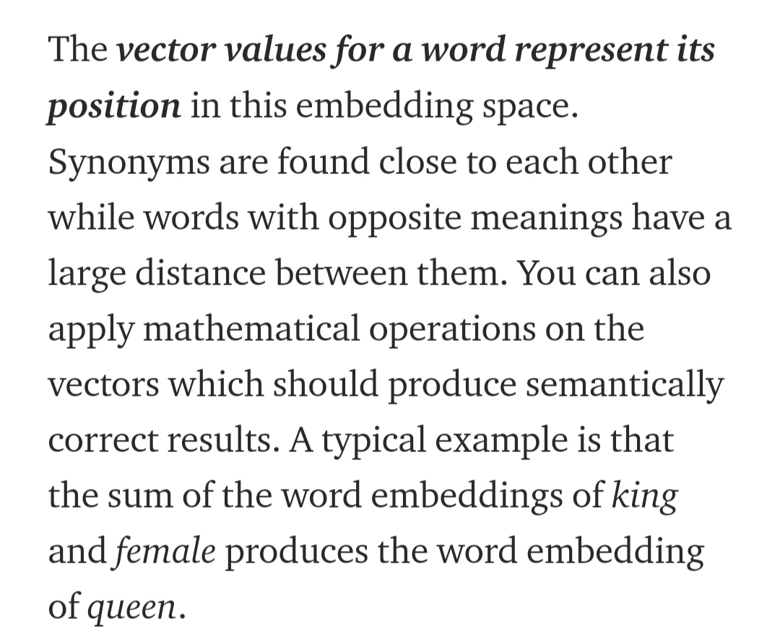

Slide 25
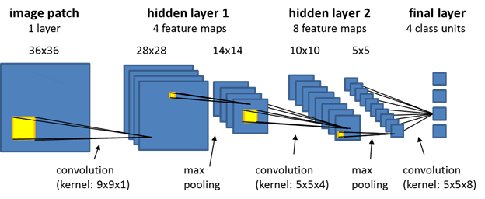
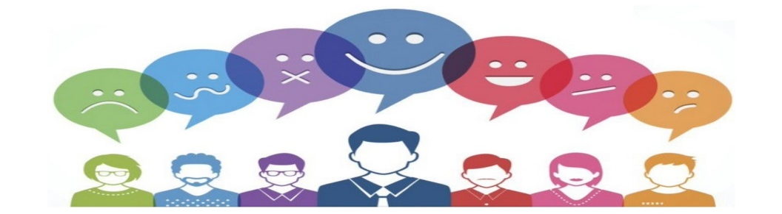
Convolutional Neural Networks
In deep learning, a convolutional neural network (CNN, or ConvNet) is a class of deep neural network, most commonly applied to analyze visual imagery. They are also known as shift invariant or space invariant artificial neural networks (SIANN), based on the shared-weight architecture of the convolution kernels or filters that slide along input features and provide translation equivariant responses known as feature maps. Counter-intuitively, most convolutional neural networks are only equivariant, as opposed to invariant, to translation. They have applications in image and video recognition, recommender systems, image classification, image segmentation, medical image analysis, natural language processing, brain-computer interfaces, and financial time series.

Slide 26
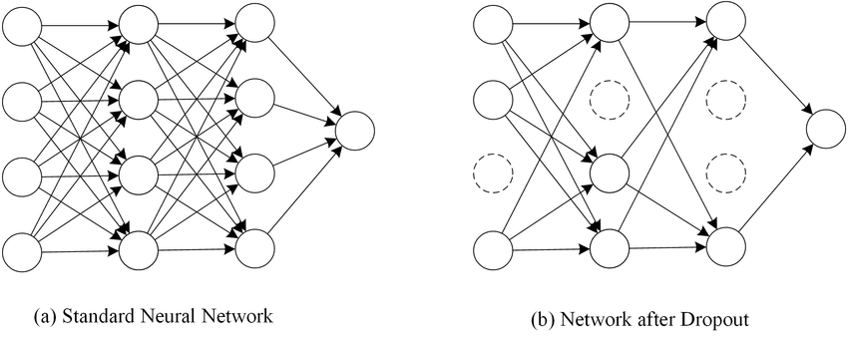
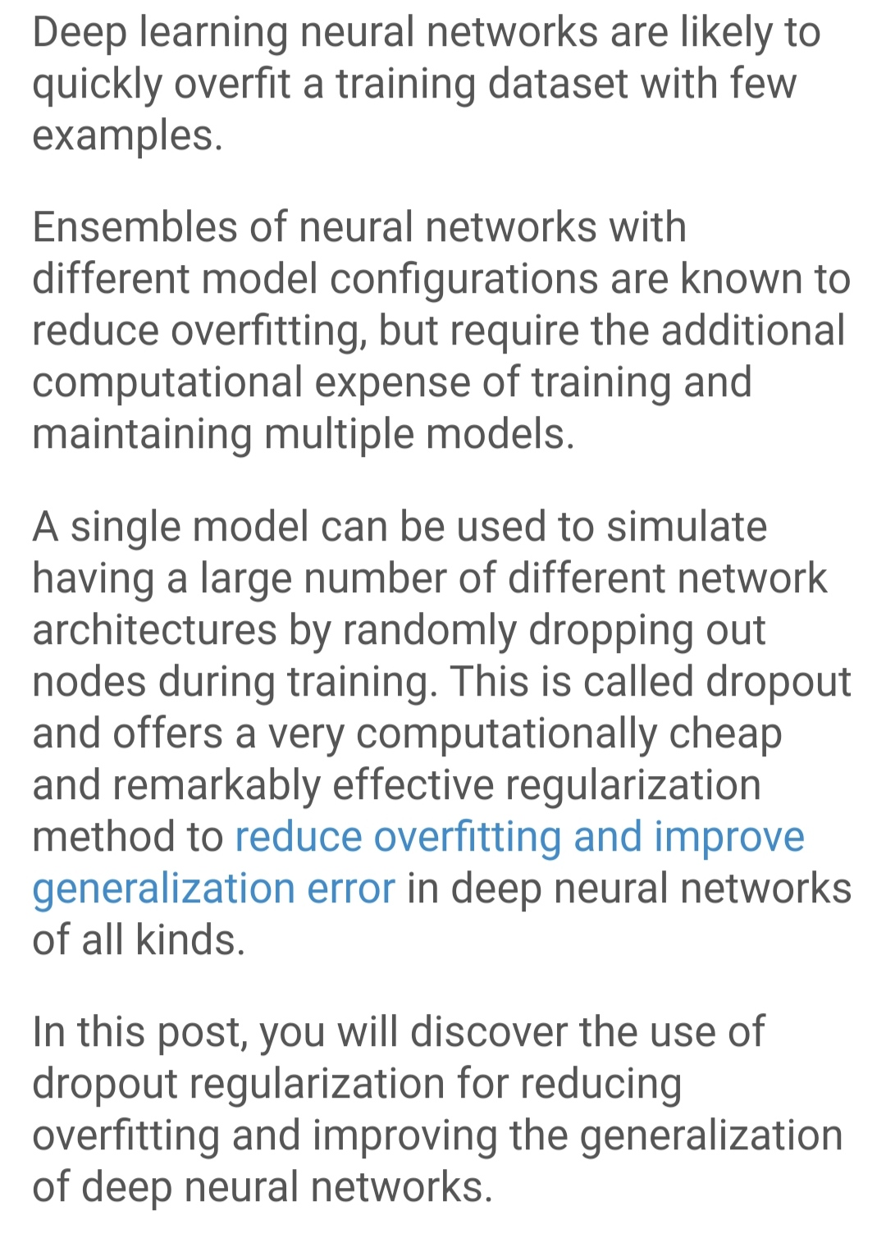
Drop Out

Slide 27
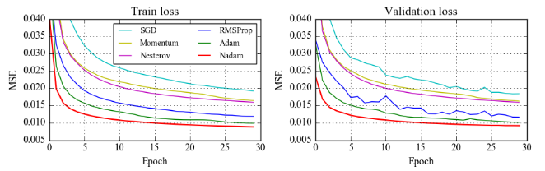
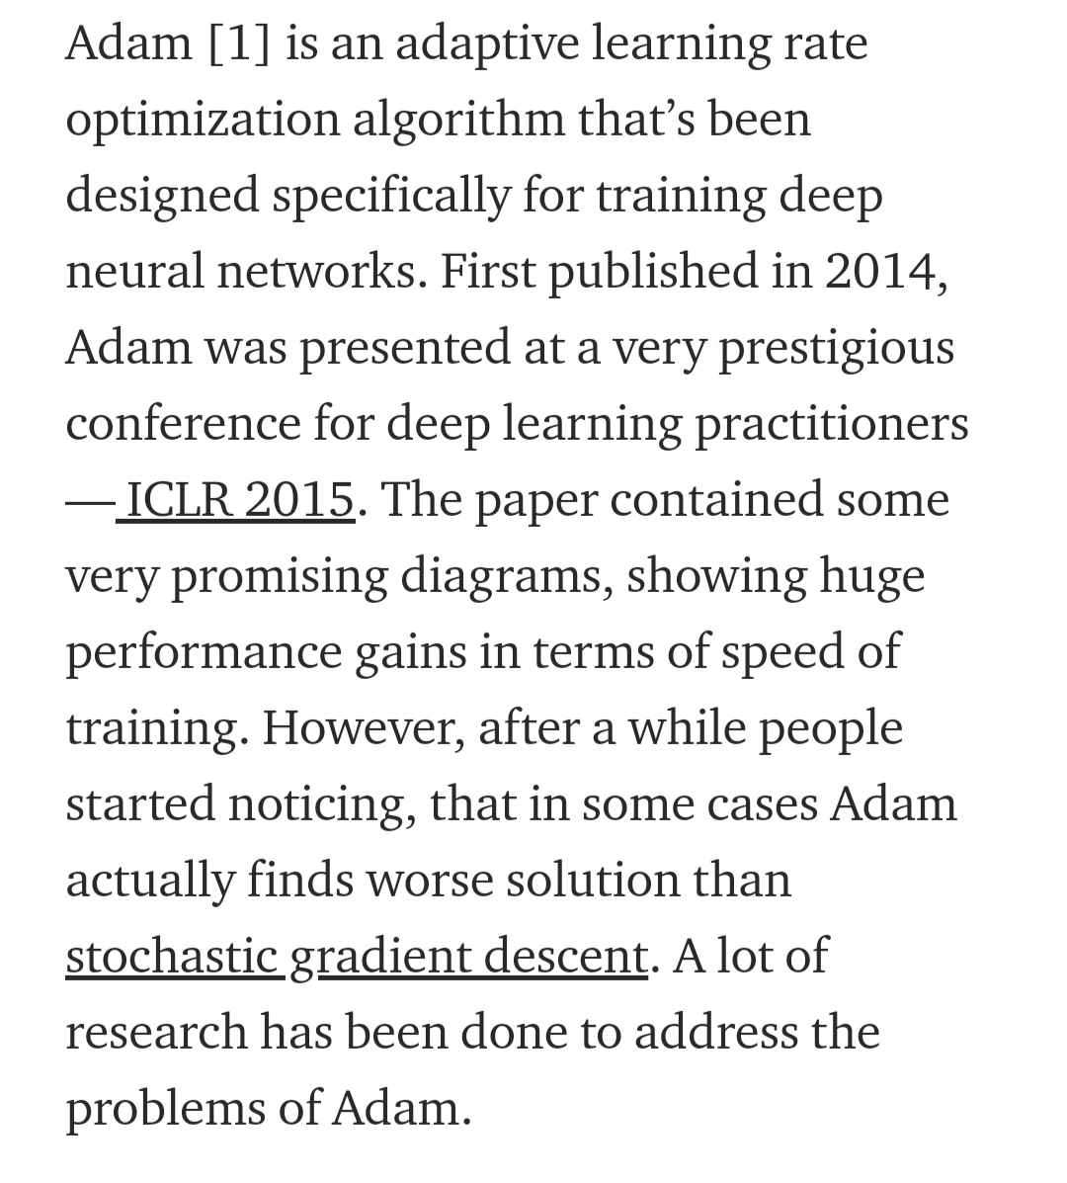
Adam Optimizer

Slide 28
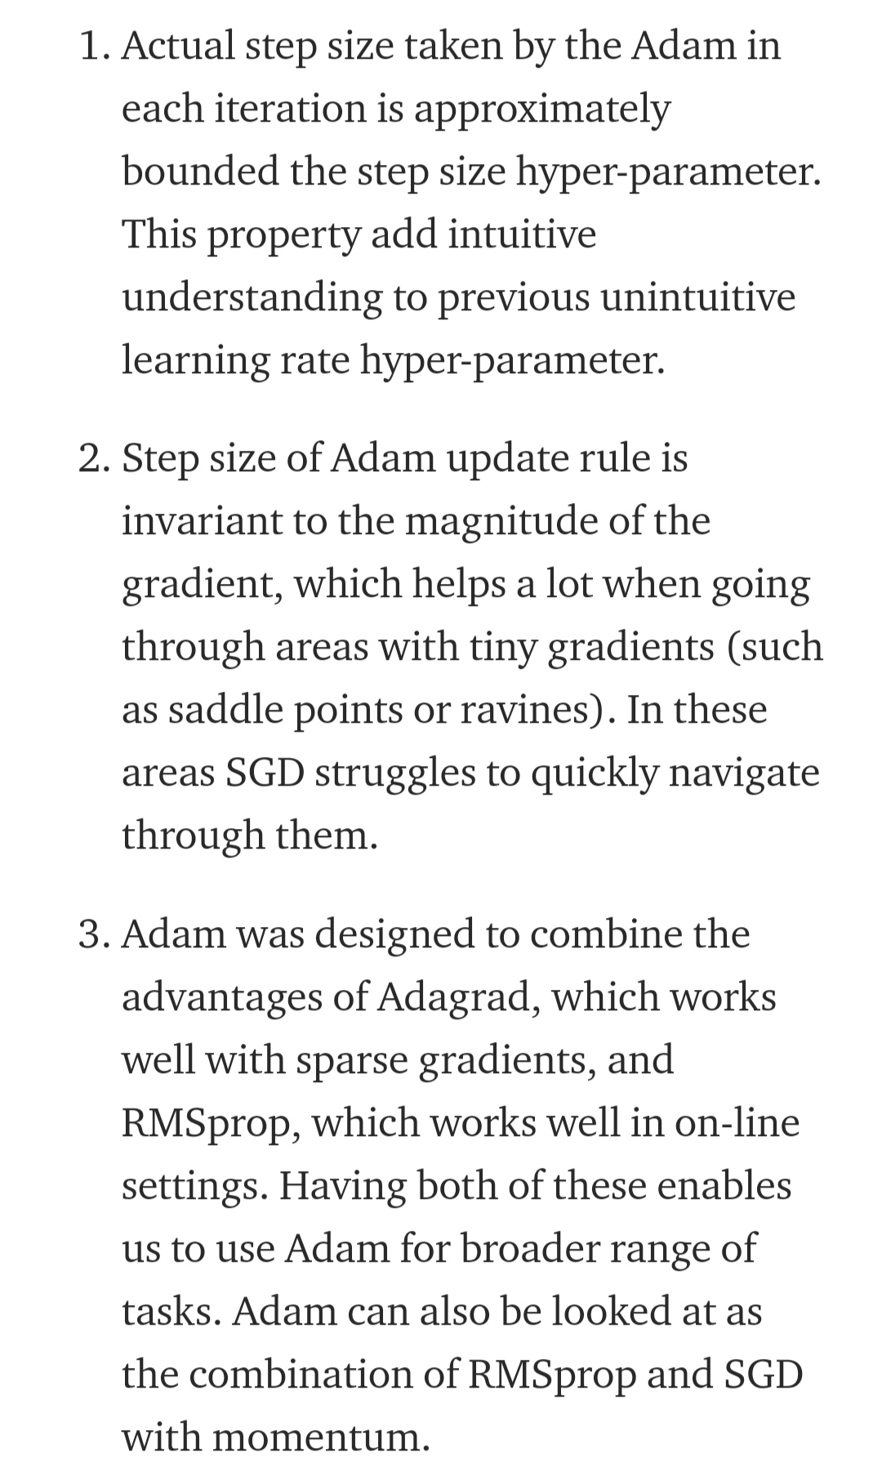
Properties Of Adam Optimizer

Slide 29
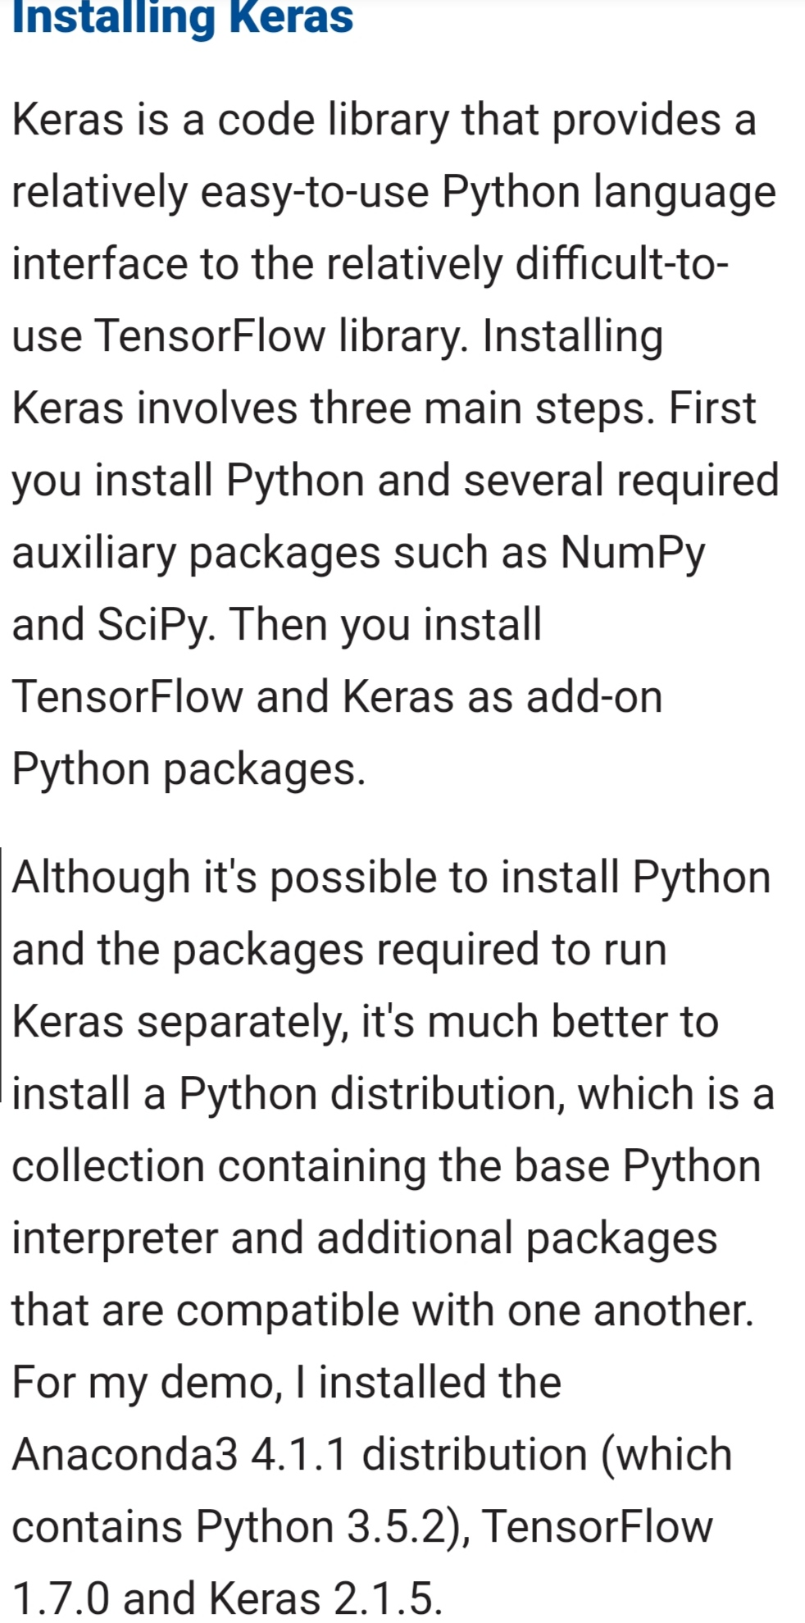
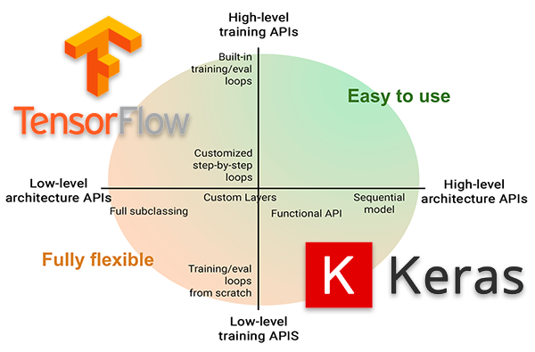
Keras

Slide 30

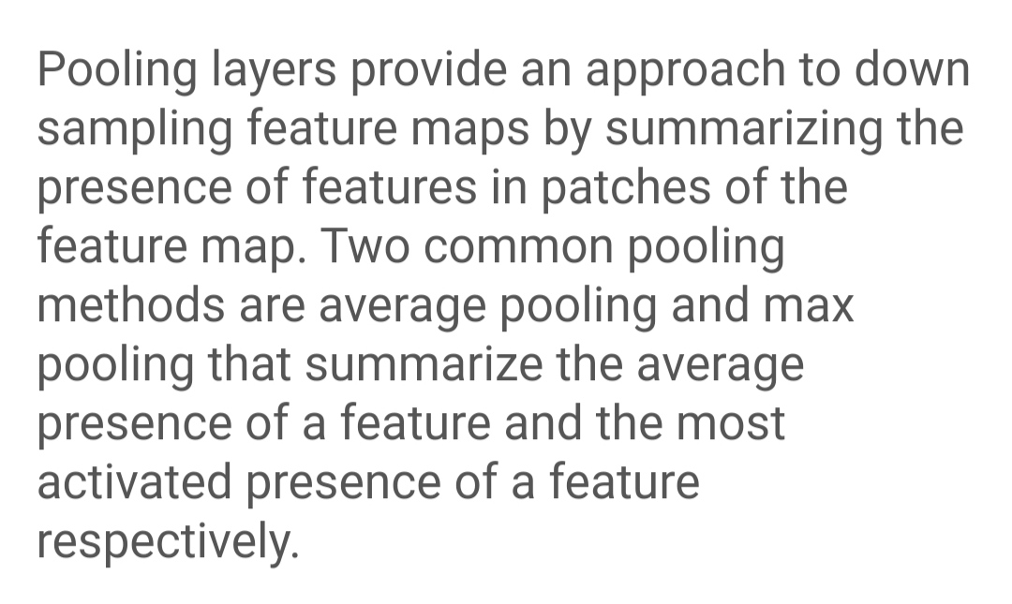
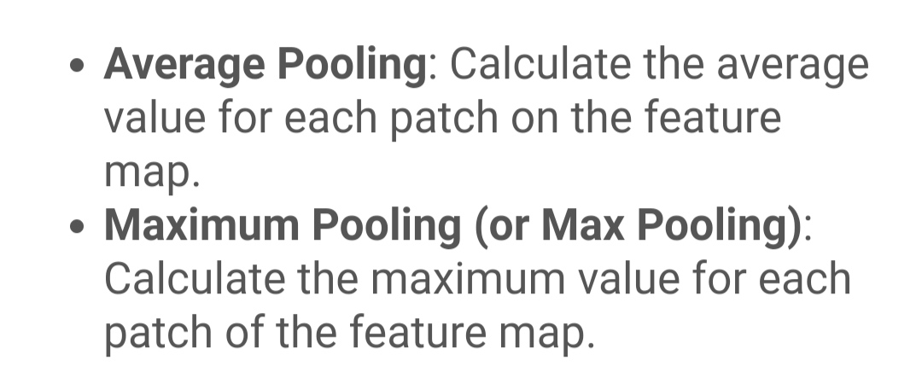
Pooling Layer and Average Pooling

Slide 31
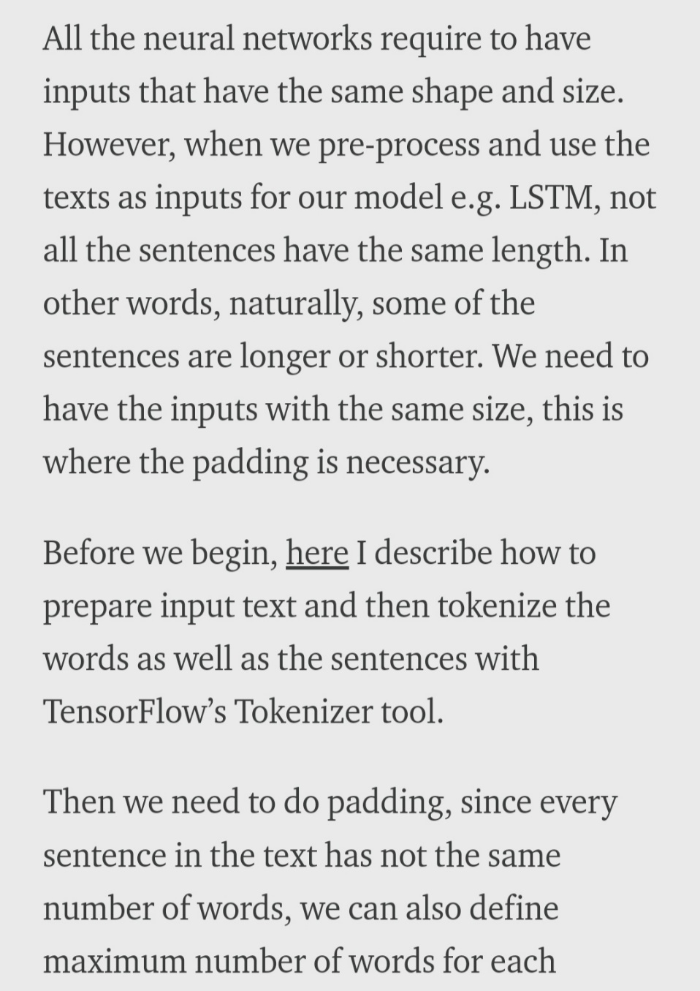
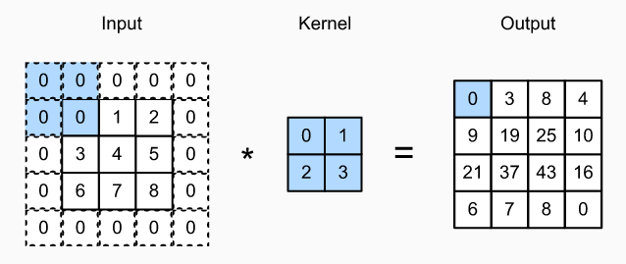
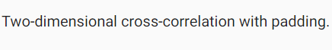
Padding

Slide 32
Software Specification
FRONT END : Tkinder by Python
BACK END : Python
PLATFORM : Windows

Slide 33
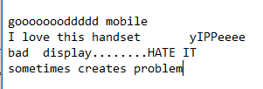
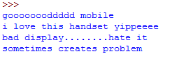
Code Description:
processReview function:
Input::
Output::

Slide 34
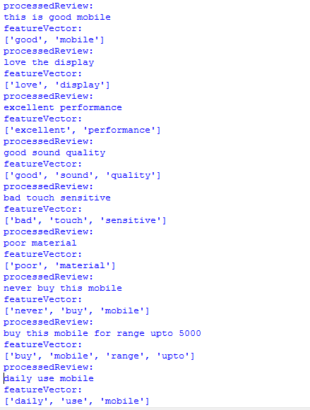
.
getFeatureVector function

Slide 35
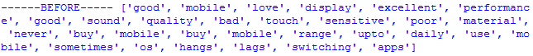
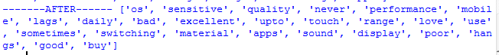
.
featureList(removes repetition)
Input::
Output::

Slide 36
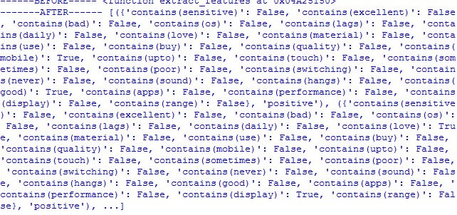
.
Training set::

Slide 37
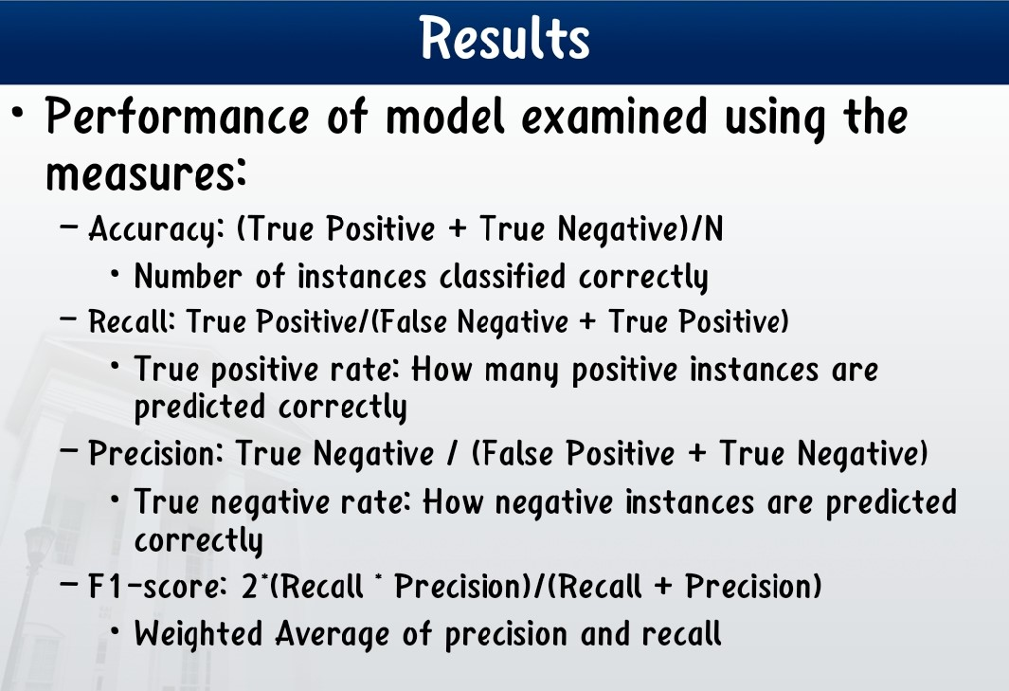

Slide 38
CONCLUSION AND FUTURE WORKS
Sentiment analysis or opinion mining is a field of study that analyzes people’s sentiments, attitudes, or emotions towards certain entities. This project deal with a fundamental problem of sentiment analysis, sentiment polarity categorization. Online product reviews from Amazon.com are selected as data used for this project.
We plan to use more exhaustive techniques in future to build a full-fledged model that is able to analyse a large set of data in a little time and with good accuracy.

Slide 39
References
https://www.GeeksforGeeks.org/
https://www.python.org/
https://www.coursera.org/
https://docs.python.org/3/tutorial/
https://www.Medium.com/
https://www.google.com/
https://www.Medium.com/
https://www.Wikipedia.org/

Slide 40


Thank You

